Slide 1
Burke’s theorem and networks of queues
Shanghai Jiao Tong University

Slide 2
System Reversibility
In the backward direction, i.e. reverse direction, departures as arrivals and arrivals as departures.
Notes:
Why do we study the reversed process?
To aid the analysis and to get more insight of the forward process
In the forward direction:
X0 = 0
X1 = 1, A1 = 1
X2 = 2, A2 = 1
X3 = 1, D3 = 1
X4 = 2, A4 = 1
….
In the backward direction, i.e. reverse direction, departure as arrivals and arrivals as departures.

Slide 3
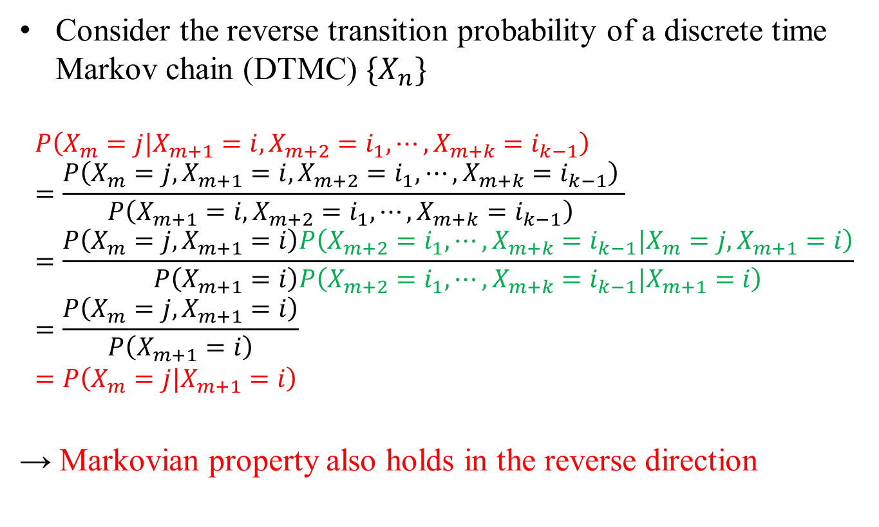
Markovian Property of Time-reversed System
Consider the reverse transition probability of a discrete time Markov chain (DTMC) $\{X_{n}\}$
$$P\left(X_{m}=j|X_{m+1}=i,X_{m+2}=i_{1},⋯,X_{m+k}=i_{k−1}\right) \\ =\frac{P\left(X_{m}=j,X_{m+1}=i,X_{m+2}=i_{1},⋯,X_{m+k}=i_{k−1}\right) }{P\left(X_{m+1}=i,X_{m+2}=i_{1},⋯,X_{m+k}=i_{k−1}\right) } \\ =\frac{P\left(X_{m}=j,X_{m+1}=i\right)P\left(X_{m+2}=i_{1},⋯,X_{m+k}=i_{k−1}|X_{m}=j,X_{m+1}=i\right)}{P\left(X_{m+1}=i\right)P\left(X_{m+2}=i_{1},⋯,X_{m+k}=i_{k−1}|X_{m+1}=i\right)} \\ =\frac{P\left(X_{m}=j,X_{m+1}=i\right)}{P\left(X_{m+1}=i\right)} \\ =P\left(X_{m}=j|X_{m+1}=i\right)$$
→ Markovian property also holds in the reverse direction
Notes:
我们现在已知的是当前的状态概率分布只跟前一个状态有关，这是正向的无记忆性。反向（当前的状态概率分布只跟后一个状态有关）是否成立需要通过前面正向无记忆性推导得出。

Slide 4

Definition of Reversibility
$P_{i,j}^{∗}≜P\left(X_{m}=j|X_{m+1}=i\right)$: backward transition probability
Definition: A DTMC is time reversible if $P_{i,j}^{∗}=P_{i,j}$, where $P_{i,j}≜P\left(X_{m+1}=j|X_{m}=i\right)$ is forward transition probability
Notes:
Why do we study the reversed process?
To aid the analysis and to get more insight of the forward process
In the forward direction:
X0 = 0
X1 = 1, A1 = 1
X2 = 2, A2 = 1
X3 = 1, D3 = 1
X4 = 2, A4 = 1
….
In the backward direction, i.e. reverse direction, departure as arrivals and arrivals as departures.

Slide 5
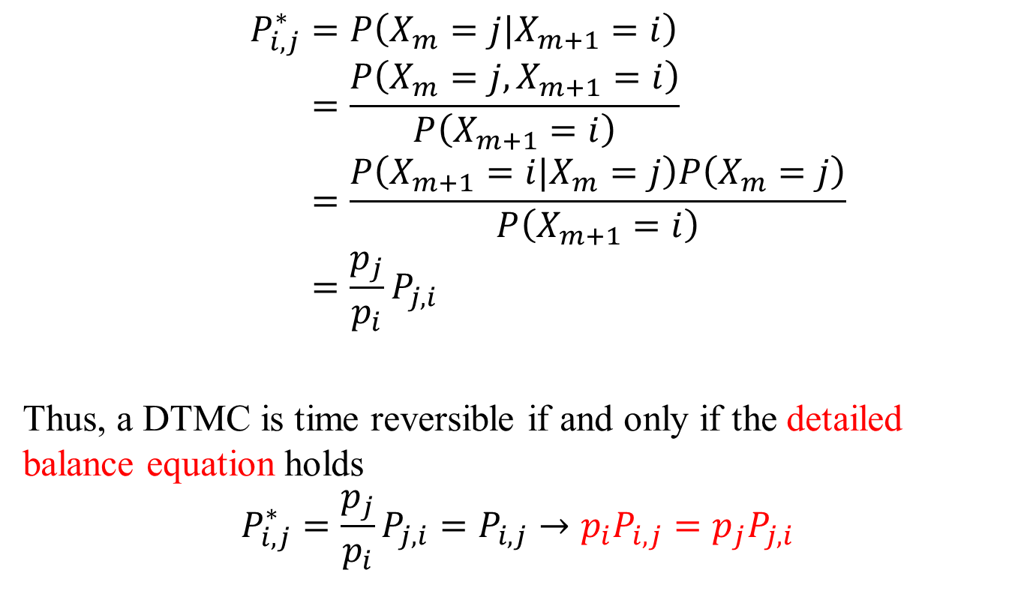
Condition of Time-reversibility
$$P_{i,j}^{∗}=P\left(X_{m}=j|X_{m+1}=i\right) \\ =\frac{P\left(X_{m}=j,X_{m+1}=i\right)}{P\left(X_{m+1}=i\right)} \\ =\frac{P\left(X_{m+1}=i|X_{m}=j\right)P\left(X_{m}=j\right)}{P\left(X_{m+1}=i\right)} \\ =\frac{p_{j}}{p_{i}}P_{j,i}$$
Thus, a DTMC is time reversible if and only if the detailed balance equation holds
$$P_{i,j}^{∗}=\frac{p_{j}}{p_{i}}P_{j,i}=P_{i,j}→p_{i}P_{i,j}=p_{j}P_{j,i}$$

Slide 6
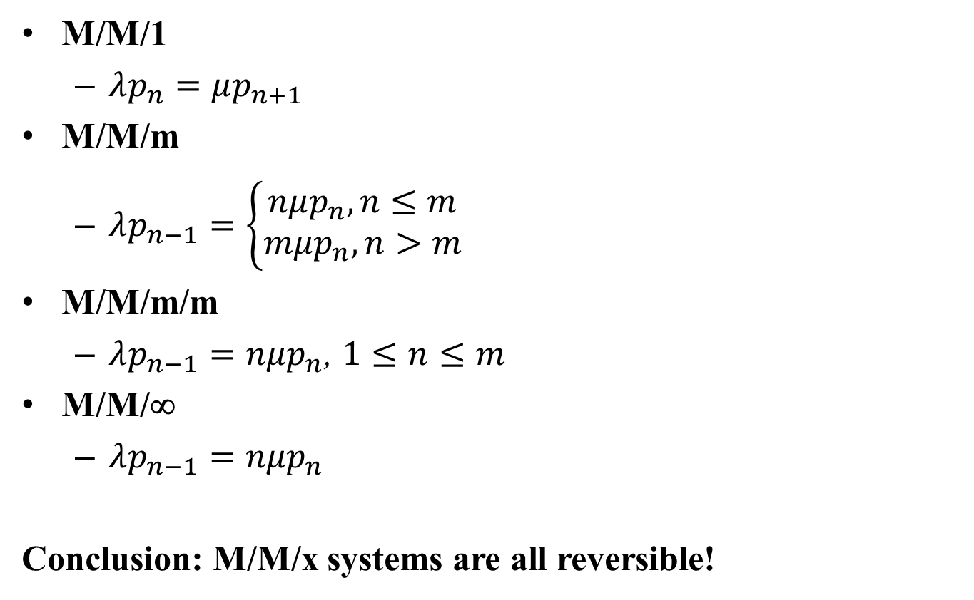
Recall: M/M/x Systems
M/M/1
  $λp_{n}=μp_{n+1}$
M/M/m
  $λp_{n−1}=\left\{\begin{aligned}nμp_{n}, n≤m \\ mμp_{n}, n>m\end{aligned}\right.$
M/M/m/m
  $λp_{n−1}=nμp_{n}$, $1≤n≤m$
M/M/∞
  $λp_{n−1}=nμp_{n}$
Conclusion: M/M/x systems are all reversible!

Slide 7

Properties of Reversed Chains
Reversed chain has the same stationary distribution of forward chain, i.e., same $p_{i}$
In a time reversible system, departure process in the forward process corresponds to the arrival process of the reversed process, and vice versa

Slide 8

Burke’s Theorem
Consider an M/M/x system with arrival rate $λ$. Suppose that the system starts in the steady state. Then the following is true:
The departure process is a Poisson process with rate $λ$ (see 3rd property of reversed chain)
At each time $t$, the number of customers in the system is independent of the sequence of departure times prior to $t$
Notes:
B说明系统刚刚有大量输出的时候并不意味着系统中现在有大量的顾客

Slide 9
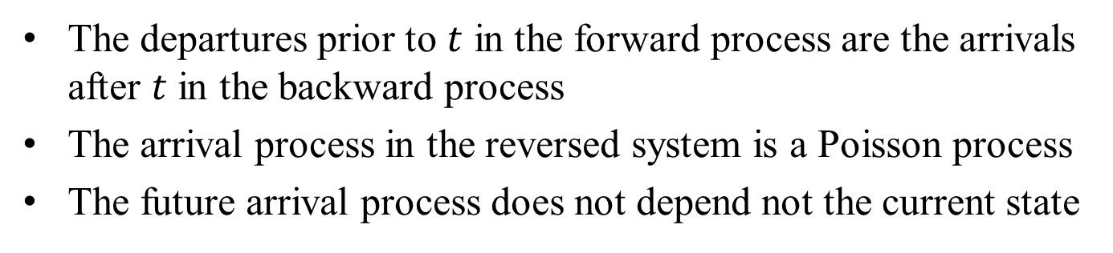
Proof of (b)
The departures prior to $t$ in the forward process are the arrivals after $t$ in the backward process
The arrival process in the reversed system is a Poisson process
The future arrival process does not depend not the current state

Slide 10


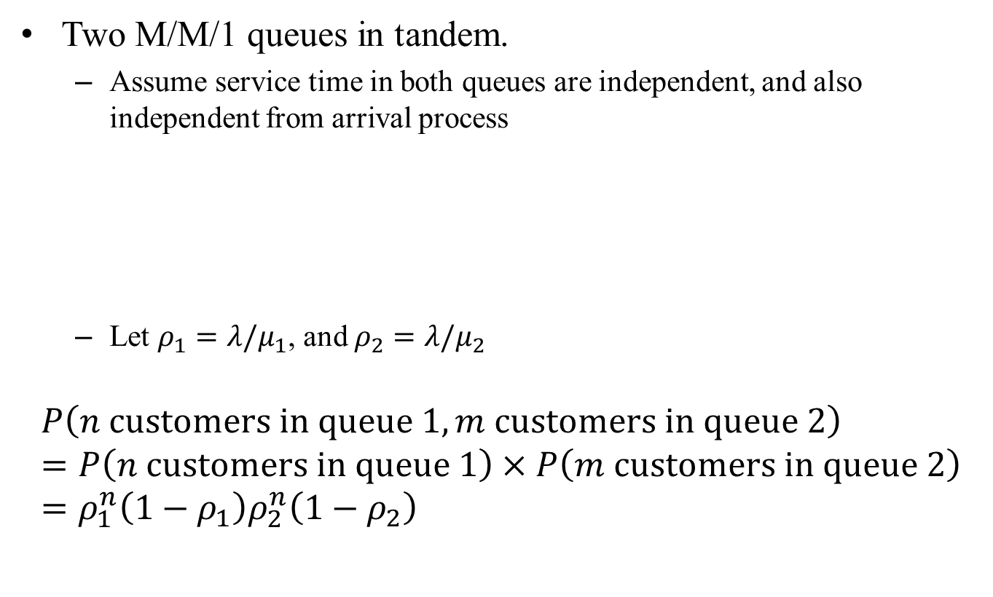



Example
Two M/M/1 queues in tandem.
  Assume service time in both queues are independent, and also independent from arrival process
  Let $ρ_{1}=λ/μ_{1}$, and $ρ_{2}=λ/μ_{2}$
$$P\left(n customers in queue 1, m customers in queue 2\right) \\ =P\left(n customers in queue 1\right)×P\left(m customers in queue 2\right) \\ =ρ_{1}^{n}\left(1−ρ_{1}\right)ρ_{2}^{n}\left(1−ρ_{2}\right)$$
Poisson $λ$
Queue 1
$$μ_{1}$$
$$λ$$
Queue 2
$$μ_{2}$$
$$λ$$

Slide 11
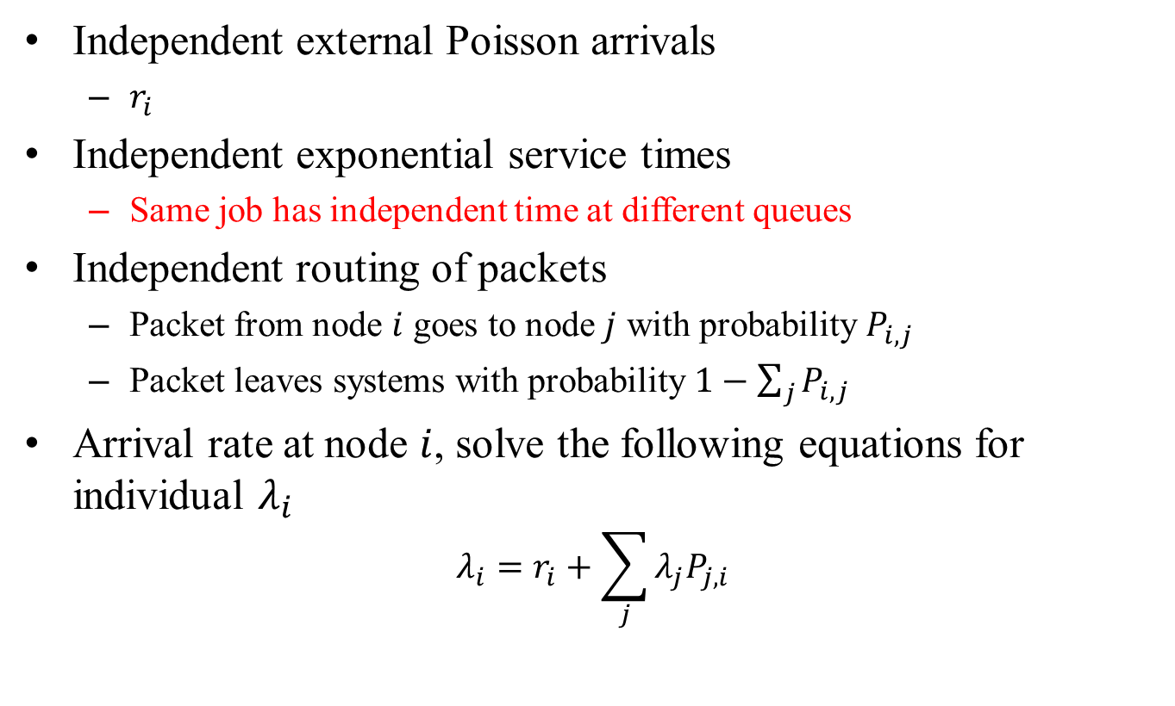
Jackson Networks
Independent external Poisson arrivals
  $r_{i}$
Independent exponential service times
  Same job has independent time at different queues
Independent routing of packets
  Packet from node $i$ goes to node $j$ with probability $P_{i,j}$
  Packet leaves systems with probability $1−\sum_{j}{P_{i,j}}$
Arrival rate at node $i$, solve the following equations for individual $λ_{i}$
$$λ_{i}=r_{i}+\sum_{j}{λ_{j}P_{j,i}}$$
External arrival
Internal routed from other nodes

Slide 12
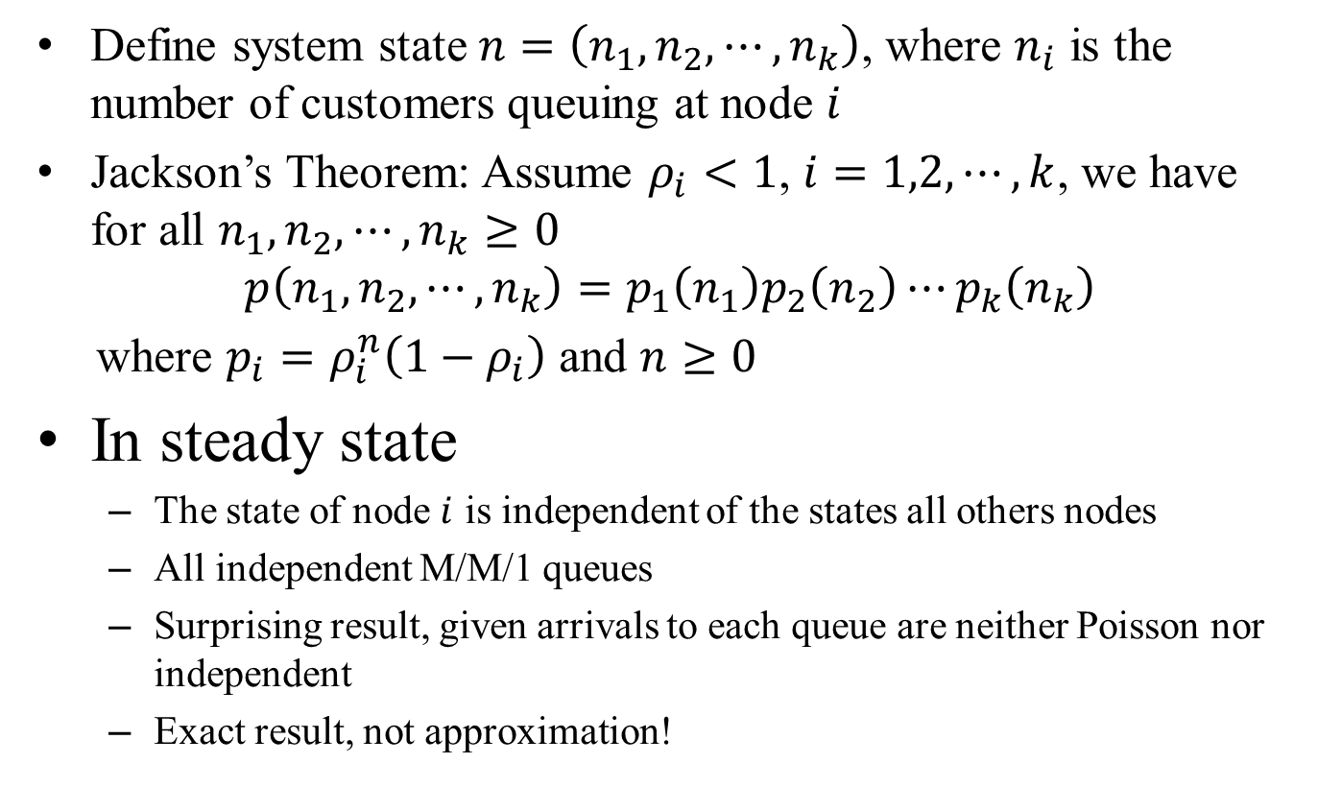
Jackson’s Theorem
Define system state $n=\left(n_{1},n_{2},⋯,n_{k}\right)$, where $n_{i}$ is the number of customers queuing at node $i$
Jackson’s Theorem: Assume $ρ_{i}<1$, $i=1,2,⋯,k$, we have for all $n_{1},n_{2},⋯,n_{k}≥0$
$$p\left(n_{1},n_{2},⋯,n_{k}\right)=p_{1}\left(n_{1}\right)p_{2}\left(n_{2}\right)⋯p_{k}\left(n_{k}\right)$$
where $p_{i}=ρ_{i}^{n}\left(1−ρ_{i}\right)$ and $n≥0$
In steady state
  The state of node $i$ is independent of the states all others nodes
  All independent M/M/1 queues
  Surprising result, given arrivals to each queue are neither Poisson nor independent
  Exact result, not approximation!

Slide 13



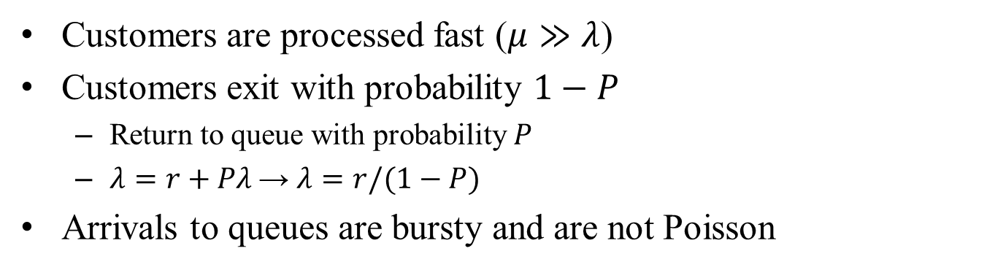



Example
$$r$$
$$λ$$
$$λ$$
$$λ\left(1−P\right)$$
$$μ≫λ$$
$$λP$$
Customers are processed fast ($μ≫λ$)
Customers exit with probability $1−P$
  Return to queue with probability $P$
  $λ=r+Pλ$→ $λ=r/(1−P)$
Arrivals to queues are bursty and are not Poisson

Slide 14





Application of Jackson’s Theorem
$$r$$
$$λ_{1}$$
$$μ_{1}$$
$$λ_{2}$$
$$μ_{2}$$
3/8
3/8
2/8

