Slide 1
Chapter 11: Disjoint Set

Slide 2
Outline
Equivalence Relation and Equivalence Class (等价关系与等价类)
Disjoint Set (不相交集)
Implementation of Disjoint Set
Implementation of Disjoint Set Class
Application of Disjoint Set

Slide 3

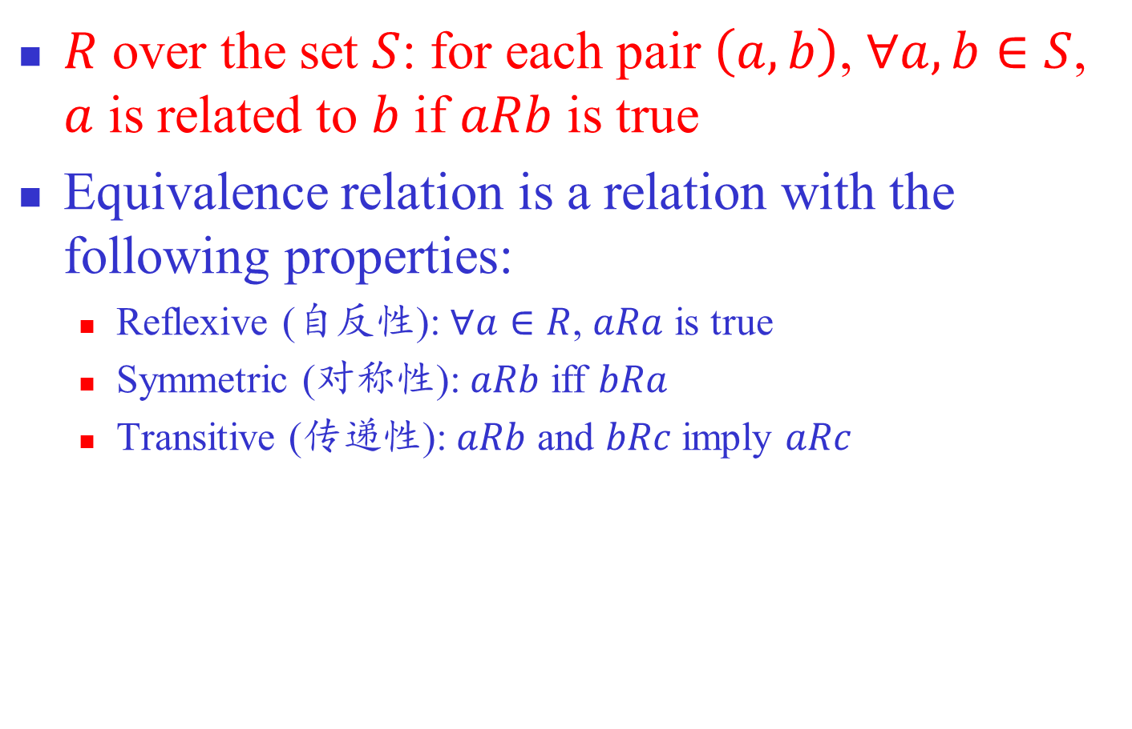
Equivalence Relation $R$
$R$ over the set $S$: for each pair $\left(a,b\right)$, $∀a,b∈S$, $a$ is related to $b$ if $aRb$ is true
Equivalence relation is a relation with the following properties:
  Reflexive (自反性): $∀a∈R$, $aRa$ is true
  Symmetric (对称性): $aRb$ iff $bRa$
  Transitive (传递性): $aRb$ and $bRc$ imply $aRc$
Notes:
对集合中的每一对元素(a,b), a,b∈S, aRb要么 是真要么是假，则称关系R（relation R）是定义 在集合S上。如果aRb为真，则称a与b相关。如果 集合中的每一对元素不是有关系就是没关系，则称该关系（relation）是定义在该集合上的。
等价关系（equivalence relation）是一种满足 以下三个特性关系R。
自反性（Reflexive）：对所有的a∈R，aRa为真。
对称性（Symmetric）：当且仅当bRa时，aRb。
传递性（Transitive）：aRb和bRc隐含aRc。

Slide 4
Example
Family relation
  You are your relative (reflexive)
  A and B are relatives ⇒ B and A are relatives (symmetric)
  A and B are relatives and B and C are relatives ⇒ A and C are relatives (transitive)
Connective relation
Notes:
亲戚关系就是一个等价关系。自己和自己是亲 戚；如果A和B是亲戚，则B和A也是亲戚；如果A 和B是亲戚，B和C是亲戚，则A和C也是亲戚。因 此，亲戚关系具有自反性、对称性和传递性，所 以是等价关系。
同样，如果通过公路可以从小镇a到小镇b，则称 a与b是有关系的。如果道路是双向的，那么公路交通网络中的到达关系也是一个等价关系。

Slide 5
Operations on the Equivalent Class
Check if two elements are equivalent
Add equivalence relationship between two elements
Notes:
判断两个元素之间是否有等价关系
在两个元素间添加等价关系

Slide 6

Representation of Equivalence Relation
Straightforward representation: 2-D array
  $a\left[i\right]\left[j\right]$ = true if $iRj$
Example: storage space consuming
  1. Symmetric: $a\left[i\right]\left[j\right]$ = true ⇒ $a\left[j\right]\left[i\right]$ = true
  2. Transitive: $a\left[i\right]\left[j\right]$ = true & $a\left[j\right]\left[k\right]$ = true ⇒ $a\left[i\right]\left[k\right]$ = true
 | 0 | 1 | 2 | 3 | 4
0 | true | true |  | true
1 | true | true |  | true
2 |  |  | true |  | true
3 | true | true |  | true
4 |  |  | true |  | true
Notes:
二维数组是最直接的方法，但造成浪费

Slide 7
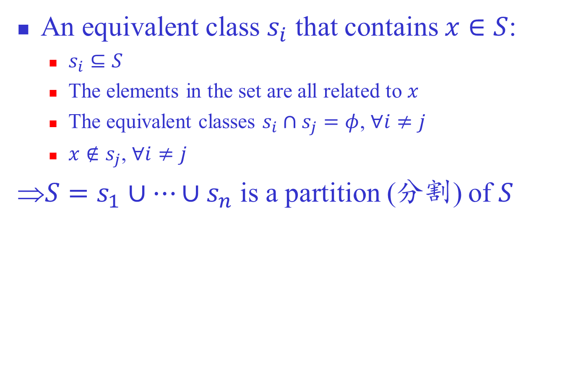

Equivalent Class
An equivalent class $s_{i}$ that contains $x∈S$:
  $s_{i}⊆S$
  The elements in the set are all related to $x$
  The equivalent classes $s_{i}∩s_{j}=φ$, $∀i≠j$
  $x∉s_{j}$, $∀i≠j$
⇒$S=s_{1}∪⋯∪s_{n}$ is a partition (分割) of $S$
$$S=\left\{1,2,3;4,5,6,7;8,9\right\}$$
Notes:
等价类可以实现比较优化的存储方式

Slide 8
Outline
Equivalence Relation and Equivalence Class (等价关系与等价类)
Disjoint Set (不相交集或并查集)
Implementation of Disjoint Set
Implementation of Disjoint Set Class
Application of Disjoint Set

Slide 9

Disjoint Set
$S$ is a disjoint set, if
  $S=s_{1}∪⋯∪s_{n}$
  $s_{i}∩s_{j}=φ$, $∀i≠j$
Example
$$S=\left\{1,2,3;4,5,6,7;8,9\right\}$$
Notes:
等价类形成了集合S的一种分割。对于任意 两个等价类Si和Sj，Si∩Sj=Φ，将所有的等价类并起来就是集合S。
这样的集合也称为不相交集合。

Slide 10
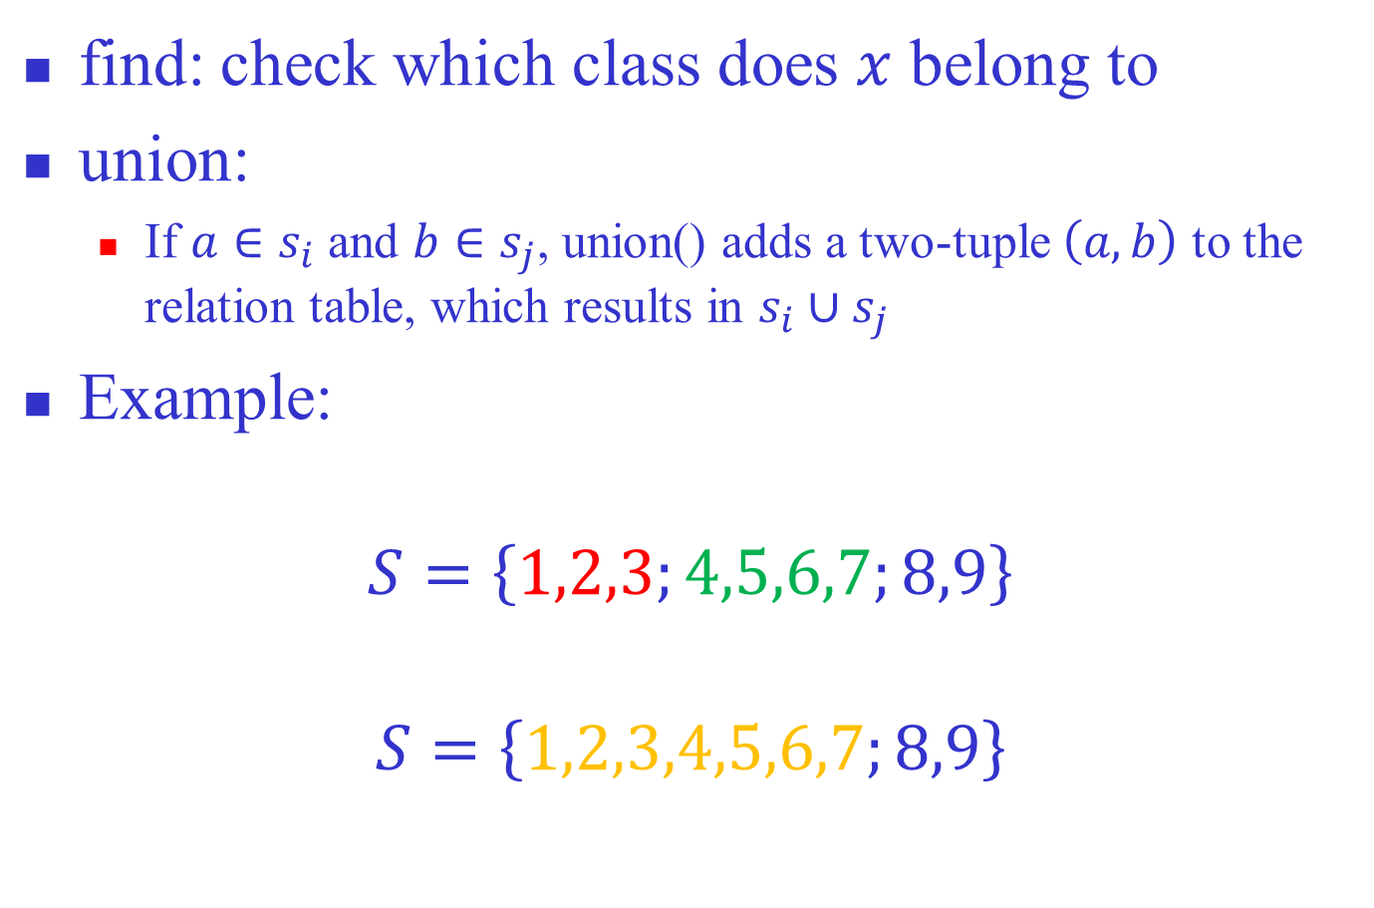
Operations of Disjoint Class
find: check which class does $x$ belong to
union:
  If $a∈s_{i}$ and $b∈s_{j}$, union() adds a two-tuple $\left(a, b\right)$ to the relation table, which results in $s_{i}∪s_{j}$
Example:
$$S=\left\{1,2,3;4,5,6,7;8,9\right\}$$
$$S=\left\{1,2,3,4,5,6,7;8,9\right\}$$
Notes:
把3和4的等价关系添加到表中，那么两个子集就合并成一个大的等价类，这是由于等价关系的传递性

Slide 11
Outline
Equivalence Relation and Equivalence Class (等价关系与等价类)
Disjoint Set (不相交集)
Implementation of Disjoint Set
  Storage
  Operations
Implementation of Disjoint Set Class
Application of Disjoint Set

Slide 12
Storage Structure
Nodes are numbered by 0, …, N-1
Each class is a tree named by its root
  Parents representation: a[i] = index of parent
  a[i] = -1 if a[i] is a root
The disjoint set is a forest
0 | 1 | 2 | 3 | 4 | 5 | 6 | 7 | 8 | 9 | 10 | 11 | 12 | 13 | 14
-1 | 0 | 0 | 0 | -1 | 4 | -1 | 6 | 6 | -1 | 9 | 9 | 11 | 12 | 12
Notes:
每个等价类表示为一棵树，等价类的名字为根结点的名字。这棵树不一定是二叉树。整个集合是一片森林
因为每个节点只需要知道父节点，可以采用双亲表示法，用一个数组保存。数组s[i] 的值为i的父节点的下标。如s[i]=-1，表示i是某棵树的根。

Slide 13
union
Union of two subsets = merge two trees
  Constant time complexity
0 | 1 | 2 | 3 | 4 | 5 | 6 | 7 | 8 | 9 | 10 | 11 | 12 | 13 | 14
-1 | 0 | 0 | 0 | -1 | 4 | 4 | 6 | 6 | -1 | 9 | 9 | 11 | 12 | 12
Notes:
为了执行两个集合的union操作，我们归并 这两棵树，将一棵树的根作为另一棵树的 孩子。这个操作很明显是常量时间。
元素x的find操作返回包含x的树的根。完成该操作的时间正比于从x到根的路径上的结点数。最坏情况可能是O(N)。

Slide 14

find
Return the equivalence class that $x$ belongs to
find(x)==find(y) if x and y are in the same class
  Worst case: $O\left(n\right)$?
find(13) = 9
0 | 1 | 2 | 3 | 4 | 5 | 6 | 7 | 8 | 9 | 10 | 11 | 12 | 13 | 14
-1 | 0 | 0 | 0 | -1 | 4 | -1 | 6 | 6 | -1 | 9 | 9 | 11 | 12 | 12
Notes:
为了执行两个集合的union操作，我们归并 这两棵树，将一棵树的根作为另一棵树的 孩子。这个操作很明显是常量时间。
元素x的find操作返回包含x的树的根。完成该操作的时间正比于从x到根的路径上的结点数。最坏情况可能是O(N)。

Slide 15
Discussion
High complexity of find() is induced by union()
  union() increases the height of the trees
  In worst case, union() may create a linear table
before union()
after union()
find(9) requires 9 back-traces
Idea:
We should keep the tree as low
as possible after each union()
Notes:
尽管不相交集的union操作性能很好，而 find操作的性能不佳。但find操作的性能问题是由union操作引起的。是union操作实现时没有关心所构造的树的结构。
在极端的情况下，union操作可能使树蜕化 为线性表。
改进的思想：尽量避免树的增高
按规模并
按高度并

Slide 16
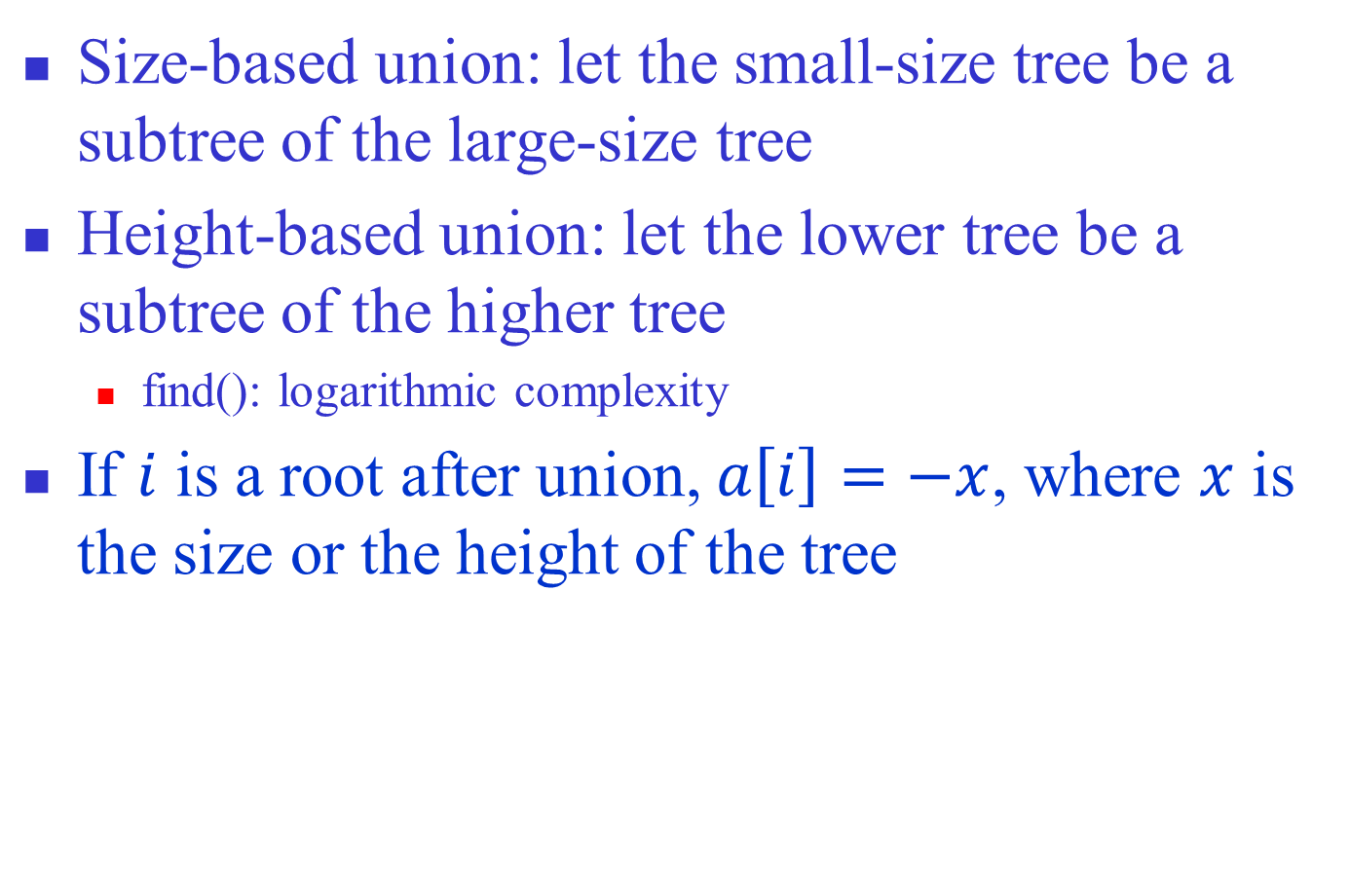
Improved union()
Size-based union: let the small-size tree be a subtree of the large-size tree
Height-based union: let the lower tree be a subtree of the higher tree
  find(): logarithmic complexity
If $i$ is a root after union, $a\left[i\right]=−x$, where $x$ is the size or the height of the tree
Notes:
将规模小的树作为规模大的树的子树，对规模相同的树可以任意选择
例如归并4和9，如将9作为4的子树，形成一棵高度为5的树。但将4作为9的子树，形成的树高度还为4

Slide 17
Size-based Union: Example
Initial state:
0 | 1 | 2 | 3 | 4 | 5 | 6 | 7 | 8 | 9 | 10 | 11 | 12 | 13 | 14 | 15
-1 | -1 | -1 | -1 | -1 | -1 | -1 | -1 | -1 | -1 | -1 | -1 | -1 | -1 | -1 | -1
Notes:
反过来，如果将9合并到4里面，整棵树高度会增加1.

Slide 18
Size-based Union: Example
union(0,1)
After union:
height of tree + 1
0 | 1 | 2 | 3 | 4 | 5 | 6 | 7 | 8 | 9 | 10 | 11 | 12 | 13 | 14 | 15
-2 | 0 | -1 | -1 | -1 | -1 | -1 | -1 | -1 | -1 | -1 | -1 | -1 | -1 | -1 | -1
Notes:
反过来，如果将9合并到4里面，整棵树高度会增加1.

Slide 19
Size-based Union: Example
union(0,2): size(0)>size(2)
After union:
height of tree
keeps unchanged
0 | 1 | 2 | 3 | 4 | 5 | 6 | 7 | 8 | 9 | 10 | 11 | 12 | 13 | 14 | 15
-3 | 0 | 0 | -1 | -1 | -1 | -1 | -1 | -1 | -1 | -1 | -1 | -1 | -1 | -1 | -1
Notes:
反过来，如果将9合并到4里面，整棵树高度会增加1.

Slide 20
Size-based Union: Example
union(0,3): size(0)>size(3)
After union:
height of tree
keeps unchanged
0 | 1 | 2 | 3 | 4 | 5 | 6 | 7 | 8 | 9 | 10 | 11 | 12 | 13 | 14 | 15
-4 | 0 | 0 | 0 | -1 | -1 | -1 | -1 | -1 | -1 | -1 | -1 | -1 | -1 | -1 | -1
Notes:
反过来，如果将9合并到4里面，整棵树高度会增加1.

Slide 21
Size-based Union: Example
Four equivalent classes
0 | 1 | 2 | 3 | 4 | 5 | 6 | 7 | 8 | 9 | 10 | 11 | 12 | 13 | 14 | 15
-4 | 0 | 0 | 0 | -3 | 4 | 4 | -7 | 6 | 7 | 9 | 9 | 11 | 12 | -2 | 14
Notes:
反过来，如果将9合并到4里面，整棵树高度会增加1.

Slide 22
Size-based Union: Example
union(0,4): size(0)>size(4)
After union:
height of tree + 1
0 | 1 | 2 | 3 | 4 | 5 | 6 | 7 | 8 | 9 | 10 | 11 | 12 | 13 | 14 | 15
-7 | 0 | 0 | 0 | 0 | 4 | 4 | -7 | 6 | 7 | 9 | 9 | 11 | 12 | -2 | 14
Notes:
反过来，如果将9合并到4里面，整棵树高度会增加1.

Slide 23
Size-based Union: Example
union(0,7): size(0)==size(7)
After union:
height of tree keeps unchanged
0 | 1 | 2 | 3 | 4 | 5 | 6 | 7 | 8 | 9 | 10 | 11 | 12 | 13 | 14 | 15
-14 | 0 | 0 | 0 | 0 | 4 | 4 | 0 | 6 | 7 | 9 | 9 | 11 | 12 | -2 | 14
Notes:
反过来，如果将9合并到4里面，整棵树高度会增加1.

Slide 24
Size-based Union: Example
union(0,7): size(0)==size(7)
After union:
height of tree + 1
0 | 1 | 2 | 3 | 4 | 5 | 6 | 7 | 8 | 9 | 10 | 11 | 12 | 13 | 14 | 15
7 | 0 | 0 | 0 | 0 | 4 | 4 | -14 | 6 | 7 | 9 | 9 | 11 | 12 | -2 | 14
Notes:
反过来，如果将9合并到4里面，整棵树高度会增加1.

Slide 25
Height-based Union: Example
0 | 1 | 2 | 3 | 4 | 5 | 6 | 7 | 8 | 9 | 10 | 11 | 12 | 13 | 14 | 15
-2 | 0 | 0 | 0 | -2 | 4 | 4 | -2 | 6 | 7 | 9 | 9 | 11 | 12 | -2 | 14
Notes:
反过来，如果将9合并到4里面，整棵树高度会增加1.

Slide 26
Height-based Union: Example
union(0,4): height(0)==height(4)
After union:
height of tree + 1
0 | 1 | 2 | 3 | 4 | 5 | 6 | 7 | 8 | 9 | 10 | 11 | 12 | 13 | 14 | 15
-3 | 0 | 0 | 0 | 0 | 4 | 4 | -2 | 6 | 7 | 9 | 9 | 11 | 12 | -2 | 14
Notes:
反过来，如果将9合并到4里面，整棵树高度会增加1.

Slide 27
Height-based Union: Example
union(0,7): height(0)>height(7)
After union:
height of tree keeps unchanged
0 | 1 | 2 | 3 | 4 | 5 | 6 | 7 | 8 | 9 | 10 | 11 | 12 | 13 | 14 | 15
-3 | 0 | 0 | 0 | 0 | 4 | 4 | 0 | 6 | 7 | 9 | 9 | 11 | 12 | -2 | 14
Notes:
反过来，如果将9合并到4里面，整棵树高度会增加1.

Slide 28
Improved Union
Height of the tree increases slowly
  Worst case for height-based merge: two trees involved in merge have the same height
    Height increases by 1 after merge
Notes:
反过来，如果将9合并到4里面，整棵树高度会增加1.

Slide 29
Improved find(): Path Compression
Motivation: if all trees are two-layer, find() will be most efficient
Algorithm modification:
  once a node is visited, its parent = root
Notes:
不相交集中，每棵子树的最理想的状态是一 棵二层的数，只有根结点和它的儿子。这时，find操作的效率最高。
改进的union算法可以降低树的高度，提高 find的效率。但当被归并的两棵树规模相同或高度相同时，树高还是会增加。
另外一种效率的改进方法是通过find操作，这种方法称为路径压缩。
当对find（x）采用路径压缩方法的话，那么在 从x到根结点的路径上的每一个结点都将自己的父 结点改为根结点。
如果x是一个很深的结点，这一改进将会大大降低树的高度
路径压缩能与按规模归并完美地兼容。路径压缩与按高度归并不完全兼容，

Slide 30
Example: find(14)
0 | 1 | 2 | 3 | 4 | 5 | 6 | 7 | 8 | 9 | 10 | 11 | 12 | 13 | 14
-6 | 0 | 0 | 0 | 2 | 4 | 3 | 6 | 6 | 3 | 9 | 9 | 11 | 12 | 12
-6 | 0 | 0 | 0 | 2 | 4 | 3 | 6 | 6 | 0 | 9 | 0 | 0 | 12 | 0

Slide 31
Comments
Modified find() is compatible with the size-based union
  Path compression does not change the tree’s size
Modified find() is not compatible with the height-based union
  How to update the height of the tree after path compression is difficult

Slide 32
Outline
Equivalence Relation and Equivalence Class (等价关系与等价类)
Disjoint Set (不相交集)
Implementation of Disjoint Set
Implementation of Disjoint Set Class
Application of Disjoint Set

Slide 33
Disjoint Set Class
//Size-based union and path comparison
class DisjointSet
{
private:
int size;
int *parent; //集合的数组，每个单元保存其父亲是谁
public:
DisjointSet(int s) ;
~DisjointSet() {delete [] parent;}
void union(int root1, int root2);
int find(int x);
};

Slide 34
Constructor
DisjointSet::DisjointSet(int n)
{
size = n;
parent = new int [size]; //初始化集合数组
for (int i=0; i<size; ++i) parent[i] = -1;
}

Slide 35
find()
//查找过程中，把所有访问到的节点的父亲改成root
int DisjointSet::find(int x)
{
if (parent[x]<0) return x; //x是根, 找到结果
return parent[x]=find(parent[x]); //x不是根, 追朔其父节点,
//并把父亲改成根
}
Example: find(5)
parent[5]=3
find(3)

Slide 36
find()
//查找过程中，把所有访问到的节点的父亲改成root
int DisjointSet::find(int x)
{
if (parent[x]<0) return x; //x是根, 找到结果
return parent[x]=find(parent[x]); //x不是根, 追朔其父节点,
//并把父亲改成根
}
Example: find(3)
parent[3]=0
find(0)

Slide 37
find()
//查找过程中，把所有访问到的节点的父亲改成root
int DisjointSet::find(int x)
{
if (parent[x]<0) return x; //x是根, 找到结果
return parent[x]=find(parent[x]); //x不是根, 追朔其父节点,
//并把父亲改成根
}
Example: find(0)
parent[0]<0, return 0

Slide 38
find()
//查找过程中，把所有访问到的节点的父亲改成root
int DisjointSet::find(int x)
{
if (parent[x]<0) return x; //x是根, 找到结果
return parent[x]=find(parent[x]); //x不是根, 追朔其父节点
//并把父亲改成根
}
Example: find(3)
return parent[3]=0

Slide 39
find()
//查找过程中，把所有访问到的节点的父亲改成root
int DisjointSet::find(int x)
{
if (parent[x]<0) return x; //x是根, 找到结果
return parent[x]=find(parent[x]); //x不是根, 追朔其父节点,
//并把父亲改成根
}
Example: find(5)
return parent[5]=0

Slide 40
union()
void DisjointSet::Union(int root1, int root2)
{ if (root1 == root2) return; //同一棵树, 无需操作
if (parent[root1] > parent[root2]) //树1的规模<树2的规模
//注意: 它们都是负值
{ parent[root2] += parent[root1]; //合并两树的规模
parent[root1] = root2;
} //树1变成树2的子树
else
{ parent[root1] += parent[root2];
parent[root2] = root1;
} //树2变成树1的子树
}

Slide 41
Outline
Equivalence Relation and Equivalence Class (等价关系与等价类)
Disjoint Set (不相交集)
Implementation of Disjoint Set
Implementation of Disjoint Set Class
Application of Disjoint Set
  Maze problem (迷宫问题)
  Last Common Ancestor (最近共同祖先问题)

Slide 42
Maze Problem
0 | 1 | 2 | 3 | 4
5 | 6 | 7 | 8 | 9
10 | 11 | 12 | 13 | 14
15 | 16 | 17 | 18 | 19
20 | 21 | 22 | 23 | 24
Notes:
把迷宫看成由MxN个矩形单元组成，入口在左上角，出口在右下角。左上角的单元与右下角的单元是连通的，单元之间用墙隔开。

Slide 43
Problem Modeling
Connectivity ⇔ equivalence relationship
Maze construction ⇔ Union of equivalent classes
0 | 1 | 2 | 3 | 4
5 | 6 | 7 | 8 | 9
10 | 11 | 12 | 13 | 14
15 | 16 | 17 | 18 | 19
20 | 21 | 22 | 23 | 24
0 | 1 | 2 | 3 | 4
5 | 6 | 7 | 8 | 9
10 | 11 | 12 | 13 | 14
15 | 16 | 17 | 18 | 19
20 | 21 | 22 | 23 | 24
{ 0; 1; 2; 3; 4;
5; 6; 7; 8; 9;
10; 11; 12; 13; 14;
15; 16; 17; 18; 19;
20; 21; 22; 23; 24 }
{0,1,4,5,6,7,8,9,10,11,12,13,14
15,16,17,18,19,20,21,22,23,24;
2; 3}
Notes:
如果把连通看成一个关系，则该关系是一个等价关系。
迷宫问题转化成等价类的归并问题。
开始时，每个单元是一个等价类。
选择相邻两个单元，判别是否在一个等价类。如果不是，敲开两个单元之间的墙，使之连通。归并两个等价类。
重复上述过程，直到所有单元都在一个等价类中。

Slide 44
Maze Construction
Initial: construct a disjoint set, in which each equivalent class contains only one cell
Randomly select two adjacent cells
  Check if two cells are in the same class
  If not, break the wall between the cells (i.e., combine the relevant classes)
Repeat the process, until the ingress cell and the egress cell are in the same class
Notes:
如果把连通看成一个关系，则该关系是一个等价关系。
迷宫问题转化成等价类的归并问题。
开始时，每个单元是一个等价类。
选择相邻两个单元，判别是否在一个等价类。如果不是，敲开两个单元之间的墙，使之连通。归并两个等价类。
重复上述过程，直到所有单元都在一个等价类中。

Slide 45
Example
If 8 and 13 are selected, we do nothing since 8 and 13 are already in the same class
0 | 1 | 2 | 3 | 4
5 | 6 | 7 | 8 | 9
10 | 11 | 12 | 13 | 14
15 | 16 | 17 | 18 | 19
20 | 21 | 22 | 23 | 24
0 | 1 | 2 | 3 | 4
5 | 6 | 7 | 8 | 9
10 | 11 | 12 | 13 | 14
15 | 16 | 17 | 18 | 19
20 | 21 | 22 | 23 | 24
Notes:
开始时假设所有的地方都有墙（除了入口和出口），所有的单元都不连通。
我们不断地随机选择一堵墙，如果由该墙分割的单元互相之间没有连通，则把墙拆除。
重复上述过程，直到连通了入口和出口，就得到了一个迷宫。
继续拆墙直到从每一个单元都能到达其他任一单元当然更好，因为这样做会在迷宫中生成更多的错误路径。

Slide 46
Example
If 13 and 18 are selected, break the wall in between since they are not in the same class
0 | 1 | 2 | 3 | 4
5 | 6 | 7 | 8 | 9
10 | 11 | 12 | 13 | 14
15 | 16 | 17 | 18 | 19
20 | 21 | 22 | 23 | 24
0 | 1 | 2 | 3 | 4
5 | 6 | 7 | 8 | 9
10 | 11 | 12 | 13 | 14
15 | 16 | 17 | 18 | 19
20 | 21 | 22 | 23 | 24
Notes:
开始时假设所有的地方都有墙（除了入口和出口），所有的单元都不连通。
我们不断地随机选择一堵墙，如果由该墙分割的单元互相之间没有连通，则把墙拆除。
重复上述过程，直到连通了入口和出口，就得到了一个迷宫。
继续拆墙直到从每一个单元都能到达其他任一单元当然更好，因为这样做会在迷宫中生成更多的错误路径。

Slide 47
Maze Generation
void createPuzzle(int size) //size为迷宫的规模
{ int num1, num2;
DisjointSet ds(size*size); //生成size*size的迷宫数组
srand(time(0));
while (ds.find(0) != ds.find(size*size-1)) { //若头尾元素未连通
while (true) { //只要没有选择到合适的两个单元，就循环
//选择两个相邻的不连通单元，并检查与四周连通性
num1 = rand() * size * size / (RAND_MAX + 1);
num2 = num1-size; //检查上方的单元
if (num2 >= 0) //若上方元素有效(num1有可能在第一行)
if (ds.find(num1) != ds.find(num2)) break; //不等价
num2 = num1 - 1; //检查左边的单元
if (num1 % size != 0) //若该条件成立则num1有左边邻居
if (ds.Find(num1) != ds.find(num2)) break;
Notes:
while (true) 是为了避免某次选择的点前后左右都已经跟它是同一个等价类了

Slide 48
Maze Gernation
num2 = num1 + size; //检查下方单元
if (num2 < size * size) //若下方元素有效
//num1有可能已在最后一行
if (ds.Find(num1) != ds.find(num2)) break;
num2 = num1 + 1; //检查右边的单元
if (num2 % size != 0) //若该条件成立则num1有右边邻居
if (ds.Find(num1) != ds.find(num2)) break;
}
//找到两个相邻但不连通的元素，则把两个元素所在类合并
ds.union(ds.find(num1), ds.find(num2));
cout << '<' << num1 << ',' << num2 << ">, ";
}
}

Slide 49
Outline
Equivalence Relation and Equivalence Class (等价关系与等价类)
Disjoint Set (不相交集)
Implementation of Disjoint Set
Implementation of Disjoint Set Class
Application of Disjoint Set
  Maze problem (迷宫问题)
  Last Common Ancestor (最近共同祖先问题)

Slide 50
Least Common Ancestor
What is the least common ancestor of 8 and 13?
How to extract this subtree?
Hint: this tree could be corresponding
to an equivalence class named by 3!
Notes:
我们利用一个等价类是一棵树的原理
如果我们能提取出这棵子树，我们就可以得到8和13的最近祖先

Slide 51
Implementation
Recall that: each tree is corresponding to an equivalent class named by its root
disjoint set + postOrder
Algorithm
  Initially, each node is an equivalent class
  During the postOrder of a node, union() the equivalent classes named by its children
  Each time a new class is generated, check if two targeted nodes are in the same class
  If they are in the same class, the name of the class is their least common ancestor
Notes:
用后序遍历加上不相交集共同完成。
我们将每一棵子树看成是一个等价类，子树的根是等价类的标志。
按后序遍历这棵树，在后序遍历的过程中计算每个结点的等价类，每次生成一个新的等价类后，就检查结点对中的两个结点是否在一个等价类中。如果在，这个等价类的标志就是他们的共同祖先。

Slide 52
Least Common Ancestor of 8 and 11
Visit 1: find(8)=8 and find(11)=11
{0; 1; 2; 3; 4; 5; 6; 7; 8; 9; 10; 11; 12; 13; 14}

Slide 53
Least Common Ancestor of 8 and 11
Visit 7: find(8)=8 and find(11)=11
{0; 1; 2, 4, 5; 3; 6; 7; 8; 9; 10; 11; 12; 13; 14}

Slide 54
Least Common Ancestor of 8 and 11
Visit 8: find(8)=8 and find(11)=11
{0; 1; 2, 4, 5; 3; 6; 7; 8; 9; 10; 11; 12; 13; 14}

Slide 55
Least Common Ancestor of 8 and 11
Visit 6: find(8)=6 and find(11)=11
{0; 1; 2, 4, 5; 3; 6,7,8; 9; 10; 11; 12; 13; 14}

Slide 56
Least Common Ancestor of 8 and 11
Visit 12: find(8)=6 and find(11)=11
{0; 1; 2, 4, 5; 3; 6,7,8; 9; 10; 12,13,14; 11}

Slide 57
Least Common Ancestor of 8 and 11
Visit 11: find(8)=6 and find(11)=11
{0; 1; 2, 4, 5; 3; 6,7,8; 9; 10; 12,13,14; 11}

Slide 58
Least Common Ancestor of 8 and 11
Visit 9: find(8)=6 and find(11)=9
{0; 1; 2, 4, 5; 3; 6,7,8; 9,10,12,13,14,11}

Slide 59
Least Common Ancestor of 8 and 11
Visit 9: find(8)=3 and find(11)=3
{0; 1; 2, 4, 5; 3,6,7,8,9,10,12,13,14,11}

Slide 60
Homework
2、3、5

