Slide 1
The Effect of Mobility on Delayed Data Offloading
Xiaoyi Zhouª, Tong Yeª, Tony T. Lee^{b}
ªShanghai Jiao Tong University, Shanghai, China
^{b}The Chinese University of Hong Kong, Shenzhen, Guangdong, China
July 26, 2018

Slide 2
Overview
Introduction
Delayed Offloading Procedure
Effect of Mobility on Delayed Offloading
  Simplified Model
  General Model
Conclusion

Slide 3
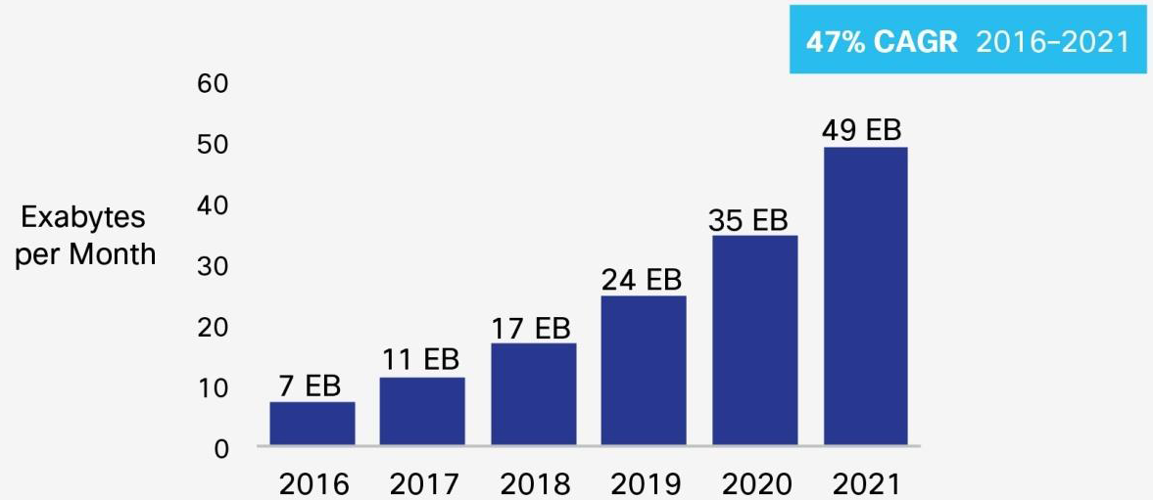
Current Status of Cellular Network
Cellular network has been overloaded
Deployment of more base stations is costly
[1] https://www.cisco.com/c/en/us/solutions/collateral/service-provider/visual-networking-index-vni/mobile-white-paper-c11-520862.html

Slide 4
Traffic Offloading via Wi-Fi Hotspots
Operators: deployment cost is low
Users: charge of Wi-Fi transmission is low
indoor users
traveling users

Slide 5
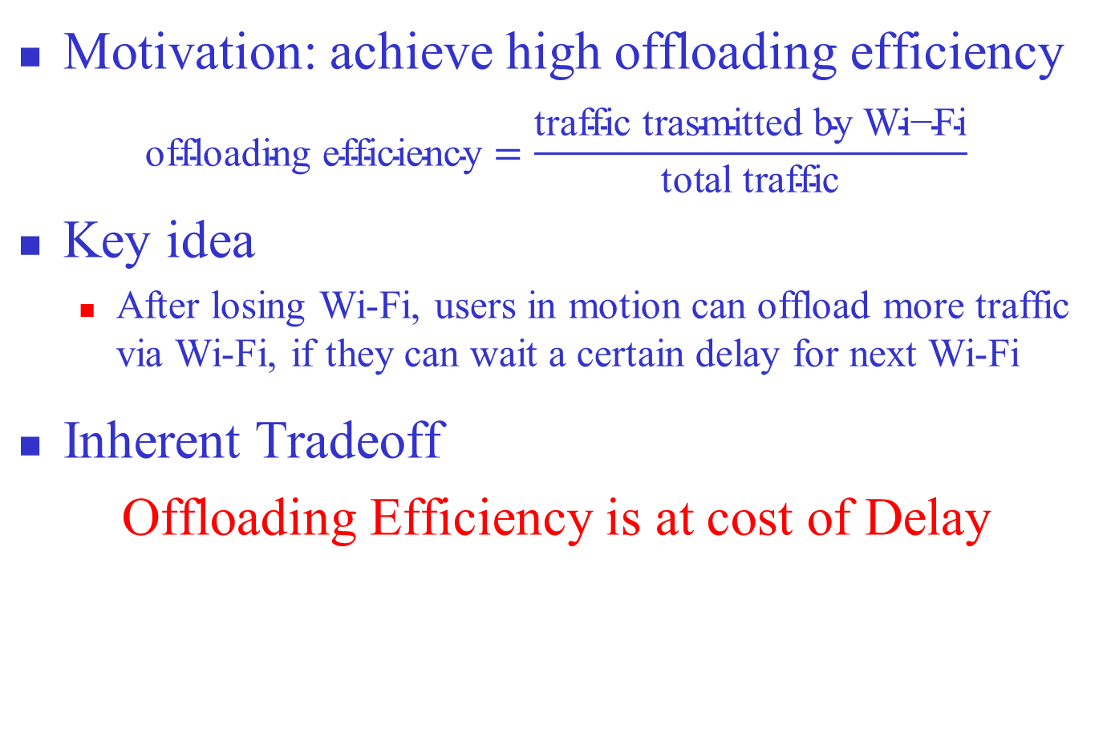
Delayed Offloading for Users in Motion
Motivation: achieve high offloading efficiency
$$\text{offloading} \text{efficiency}=\frac{\text{traffic} \text{trasmitted} \text{by} \text{Wi}\text{−}\text{Fi}}{\text{total} \text{traffic}}$$
Key idea
  After losing Wi-Fi, users in motion can offload more traffic via Wi-Fi, if they can wait a certain delay for next Wi-Fi
  Inherent Tradeoff
  Offloading Efficiency is at cost of Delay

Slide 6
Effect of Mobility on Mobile Systems
Mobility is able to enhance capacity or reduce delay in wireless communication systems
  Mobility in ad-hoc networks [1]
  Mobility in wireless ARQ communication systems [2]
  Question: Can mobility reduce delay incurred by delayed offloading?
[1] M. Grossglauer and D. N. C. Tse, “Mobility Increases the Capacity of Ad Hoc Wireless Networks,” IEEE/ACM Trans. Net., vol. 10, no. 4, 2002, pp. 477–86.
[2] L. Huang and T. T. Lee, "Generalized pollaczek-khinchin formula for markov channels," IEEE Transactions on Communications, vol. 61, pp. 3530-3540, 2013.

Slide 7
Overview
Introduction
Delayed Offloading Procedure
Effect of Mobility on Delayed Offloading
  Simplified Model
  General Model
Conclusion

Slide 8

Wireless Environment for Moving Users
Wireless channel switches between two states
  Switching rate from cellular to Wi-Fi: $f_{C}$
  Switching rate from Wi-Fi to cellular: $f_{F}$
  Average cycle time: $1/f_{F}+1/f_{C}$
  Users’ mobility: $f=\frac{1}{1/f_{F}+1/f_{C}}$

Slide 9

Delayed Offloading Procedure
If Wi-Fi is available, use Wi-Fi
Once lose Wi-Fi, set a deadline $τ$ and suspend data sending
  If Wi-Fi is available before $τ$ expires, send data via Wi-Fi
  Otherwise, use cellular

Slide 10
Overview
Introduction
Delayed Offloading Procedure
Effect of Mobility on Delayed Offloading
  Simplified Model
  General Model
Conclusion

Slide 11

A Simplified Model
Assumptions:
  Input traffic: constant fluid flow with rate $λ$
  Wi-Fi duration time, cellular duration time and deadline are all constants
  Cellular service rate $μ_{1}=$ Wi-Fi service rate $μ_{2}=μ$
A periodical service process

Slide 12


Small $τ$: $0<τ≤(μ−λ)/(μf_{C})$
Mean delay $D_{S}=\frac{μτ^{2}f}{2\left(μ−λ\right)}$ ($D_{0}=0$ for $τ=0$)
Offloading Efficiency $η_{S}=\frac{f}{f_{F}}≝R$ [1] ($η_{0}=R$)
[1] F. Mehmeti and T. Spyropoulos, “Performance Modeling, Analysis, and Optimization of Delayed Mobile Data Offloading for Mobile Users,” IEEE/ACM Trans. on Networking, vol. 21, pp. 550-564, 2017.

Slide 13


Large $τ$: $τ>1/f_{C}$
Mean delay $D_{L}=\frac{{\left(1−R\right)}^{2}μ}{2\left(μ−λ\right)f}$
Offloading efficiency $η_{L}=1$

Slide 14

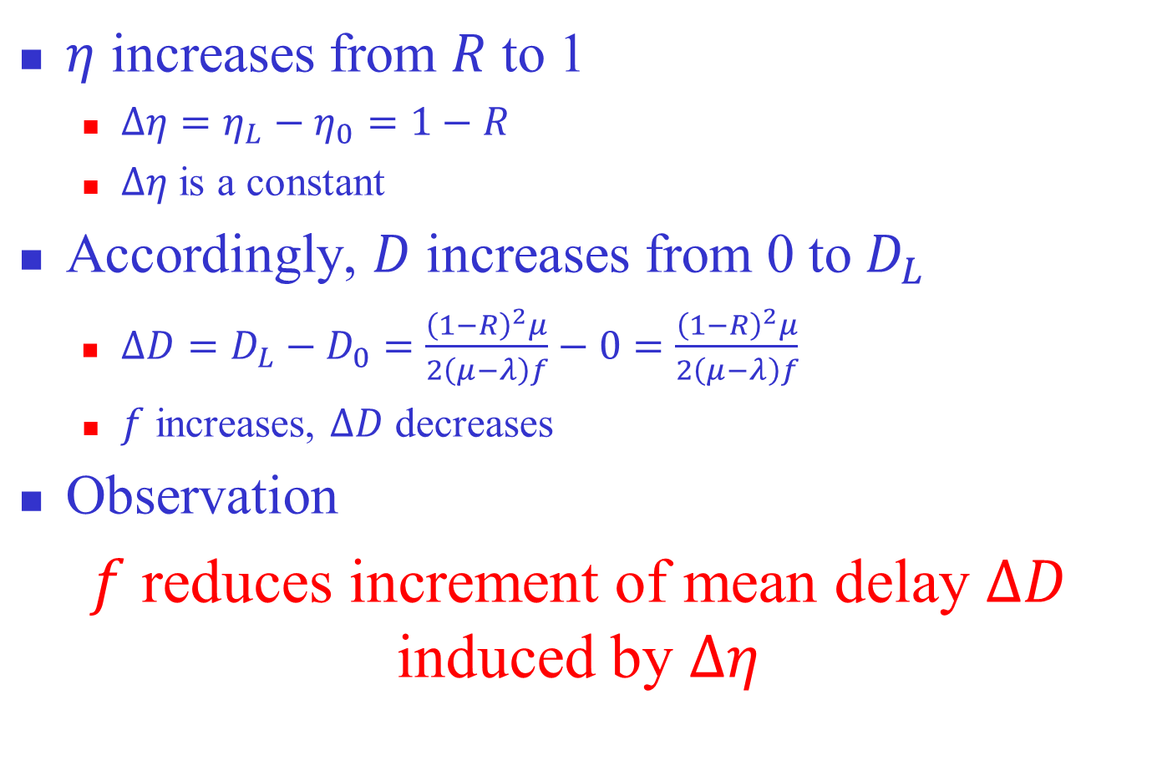
Comparision: $τ=0$ vs. $τ>1/f_{C}$
$η$ increases from $R$ to 1
  $Δη=η_{L}−η_{0}=1−R$
  $Δη$ is a constant
Accordingly, $D$ increases from 0 to $D_{L}$
  $ΔD=D_{L}−D_{0}=\frac{{\left(1−R\right)}^{2}μ}{2\left(μ−λ\right)f}−0=\frac{{\left(1−R\right)}^{2}μ}{2\left(μ−λ\right)f}$
  $f$ increases, $ΔD$ decreases
Observation
  $f$ reduces increment of mean delay $ΔD$ induced by $Δη$

Slide 15
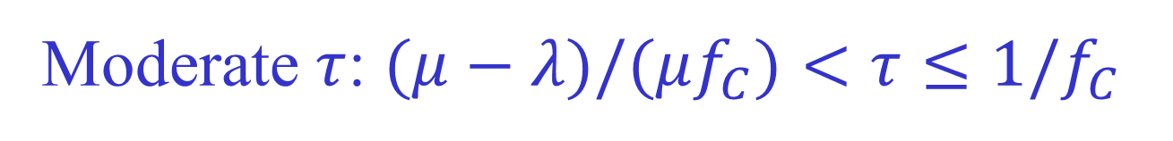

Moderate $τ$: $(μ−λ)/(μf_{C})<τ≤1/f_{C}$
Mean delay $D=\frac{μτ^{2}f}{2\left(μ−λ\right)}$
Offloading Efficiency $η=\frac{μτf+Rμ−(μ−λ)}{λ}$

Slide 16
Performance Tradeoff
Offloading efficiency is improved at cost of mean delay

Slide 17
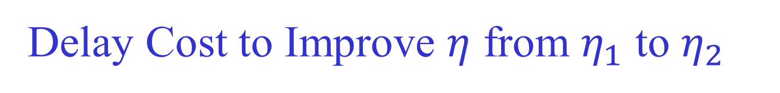
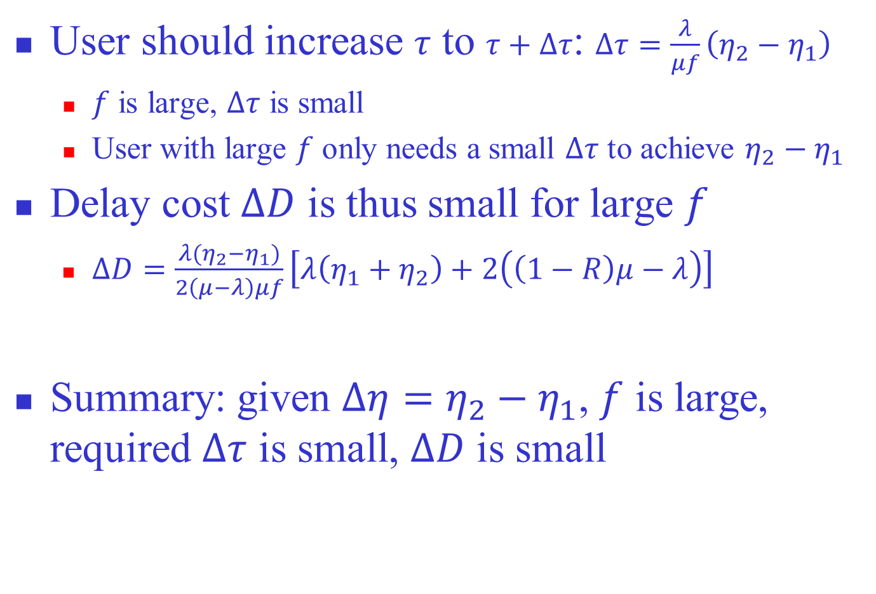
Delay Cost to Improve $η$ from $η_{1}$ to $η_{2}$
User should increase $τ$ to $τ+Δτ$: $Δτ=\frac{λ}{μf}\left(η_{2}−η_{1}\right)$
  $f$ is large, $Δτ$ is small
  User with large $f$ only needs a small $Δτ$ to achieve $η_{2}−η_{1}$
Delay cost $ΔD$ is thus small for large $f$
  $ΔD=\frac{λ(η_{2}−η_{1})}{2\left(μ−λ\right)μf}\left[λ\left(η_{1}+η_{2}\right)+2\left(\left(1−R\right)μ−λ\right)\right]$
Summary: given $Δη=η_{2}−η_{1}$, $f$ is large, required $Δτ$ is small, $ΔD$ is small

Slide 18
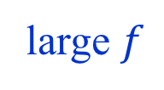
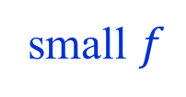


For $η=η_{1}$
$f$ is large → user reconnects to Wi-Fi quickly
→ small $τ$ is enough to achieve $η_{1}$
small $f$
large $f$

Slide 19


From $η_{1}$ to $η_{2}$
Large $f$ → small $Δτ$ enough to achieve $η_{2}−η_{1}$
→ $ΔD$ is small

Slide 20


Effect of $f$
When improving the same amount of $η$, user with larger $f$ tends to pay smaller cost in $D$

Slide 21
Overview
Introduction
Delayed Offloading Procedure
Effect of Mobility on Delayed Offloading
  Simplified Model
  General Model
Conclusion

Slide 22

Stochastic Model
Assumptions
  Input traffic is a Poisson process
  Duration times of service state 0 (delayed), 1 (cellular), 2 (Wi-Fi) are all exponentially distributed
An M/MMSP/1 queue with three service states
$f_{2,0}=f_{F}$
$$f_{0,1}=1/τ$$
$$f_{0,2}=f_{1,2}=f_{C}$$

Slide 23

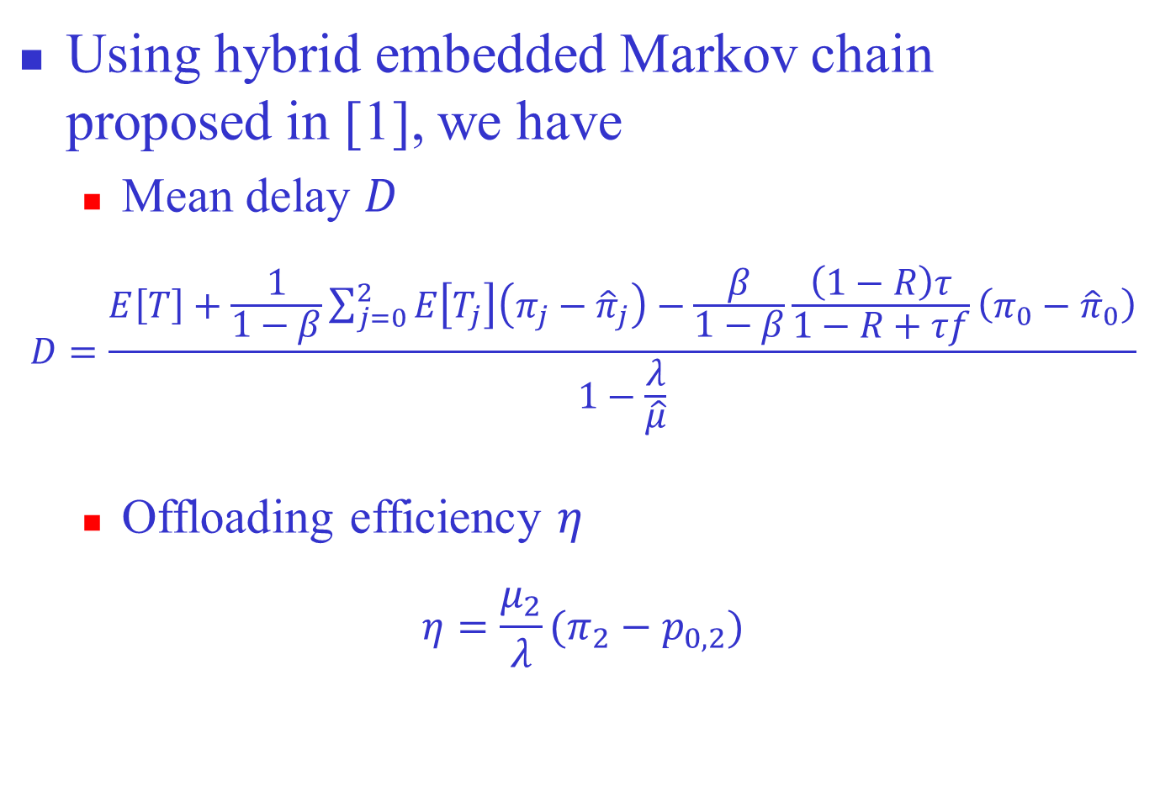
$D$ and $η$
Using hybrid embedded Markov chain proposed in [1], we have
  Mean delay $D$
$$D=\frac{E\left[T\right]+\frac{1}{1−β}\sum_{j=0}^{2}{E\left[T_{j}\right]\left(π_{j}−{\hat{π}}_{j}\right)}−\frac{β}{1−β}\frac{\left(1−R\right)τ}{1−R+τf}\left(π_{0}−{\hat{π}}_{0}\right)}{1−\frac{λ}{\hat{μ}}}$$
  Offloading efficiency $η$
$$η=\frac{μ_{2}}{λ}(π_{2}−p_{0,2})$$
[1] J. Zhang, Z. Zhou, T T. Lee and T. Ye, “Delay Analysis of Three-State Markov Channels,” in 12th Int. Conf. Queueing Theory Network Applications, vol.10591, pp. 101-117, August 2017.

Slide 24


Case 1: $μ_{1}=μ_{2}$
Two scenarios [1]:
  Pedestrian user: $f=0.005s^{−1}$
  Vehicle user: $f=0.025s^{−1}$
[1] F. Mehmeti and T. Spyropoulos, “Performance Modeling, Analysis, and Optimization of Delayed Mobile Data Offloading for Mobile Users,” IEEE/ACM Trans. on Networking, vol. 21, pp. 550-564, 2017.

Slide 25


Tradeoff between $D$ and $η$
Delay incurred by delayed offloading is small when $f$ is large

Slide 26




Case 2: $μ_{1}≠μ_{2}$
This is also true when $μ_{1}≠μ_{2}$
$$μ_{1}<μ_{2}$$
$$μ_{1}>μ_{2}$$

Slide 27

Conclusion
Our study demonstrates that: mobility can reduce queueing delay incurred by delayed offloading, because
  To increase $η$ with $Δη$, user with large $f$ only need a small increment of deadline $τ$, which leads to a small cost in delay

Slide 28

Thank You!

